Slide 1

Tech Talk Introduce Slim Framework
Friandy Dwi Noviandha (@freyandhy)
Samarinda Startup Community - Samarinda, 29 Juli 2017

Slide 2
Who Am I ?
Friandy Dwi Noviandha (Frey)
PHP Developer @ niagahoster.co.id
(PT. Web Media Technology Indonesia)
github.com/freyandhy
FB/TW : Frey Andhy / @freyandhy
freyandhy@gmail.com
frey@hostinger.com

Slide 3
Micro-framework vs Fullstack-Framework
Micro-Framework
Lumen
Slim
Silex
Phalcon
Flight
BulletPHP
Fullstack-Framework
Laravel
CakePHP
Symfony
Phalcon
CodeIgniter
Zend Framework
https://blog.appdynamics.com/engineering/php-microframework-vs-full-stack-framework/
https://www.codepolitan.com/php-microframework-vs-full-stack-framework-58ac664739bdf

Slide 4

Slim Framework
Slim Framework dibangun oleh Josh Lockhart, seorang senior developer dari newmediacampaigns.com dan Ia adalah “The man behind” PHP The Right Way.
“PHP micro framework that helps PHP developers quickly and easily write web applications and APIs. Think of it as a core set of tools with which a developer can build amazing things."

Slide 5

Application Programming Interface
Sekumpulan perintah/function yang dapat dimanfaatkan oleh seorang developer sebagai jembatan untuk berkomunikasi antar Aplikasi.
Connecting Applications

Slide 6
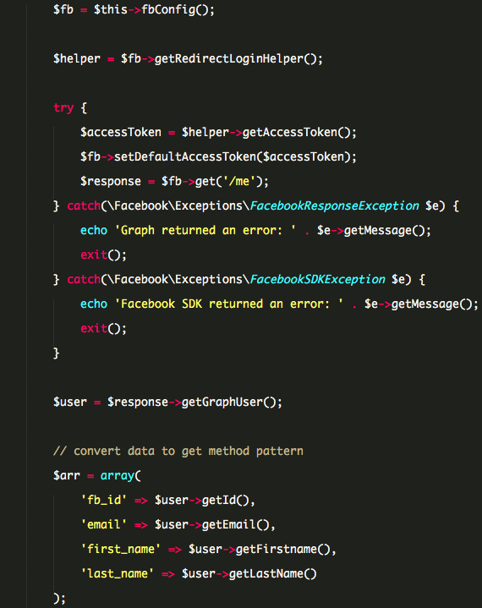

FB, I Want talk
to you !

Slide 7
SIA
Mahasiswa Dosen Fakultas Mata Kuliah
API checkLogin() – getMhs() getFakultas() – getDosen()
SIA versi mobile
Sistem Pendaftaran Wisuda
Aplikasi Perpustakaan

Slide 8
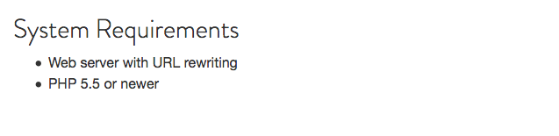
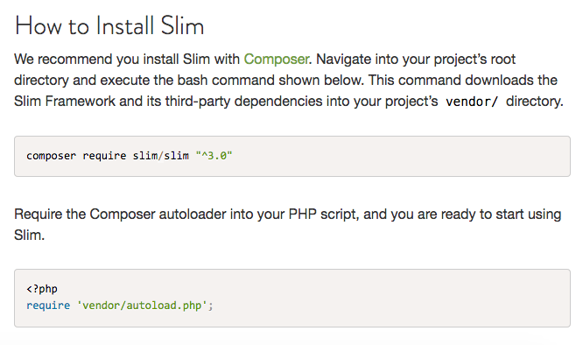
Instalasi
https://www.slimframework.com/docs/start/installation.html

Slide 9
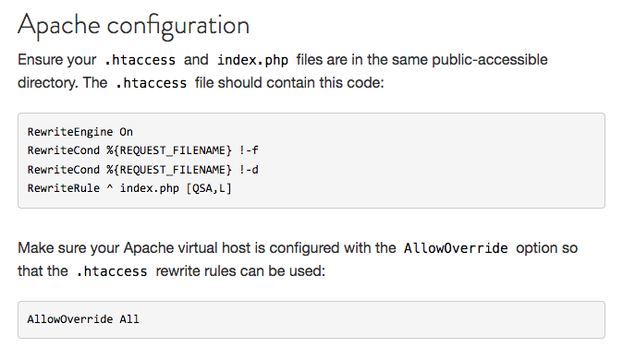
Web Server Configuration
https://www.slimframework.com/docs/start/web-servers.html

Slide 10
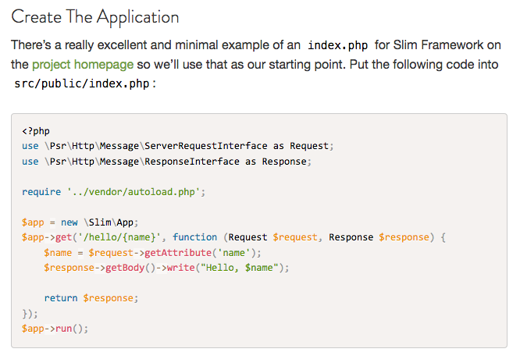
Hello World !
https://www.slimframework.com/docs/tutorial/first-app.html https://www.codepolitan.com/mengenal-slim-framework-589f4003286cb

Slide 11
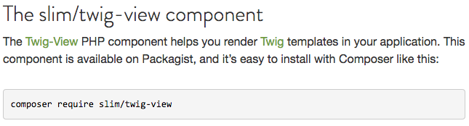
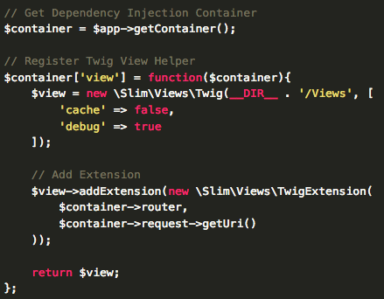
Twig-View
https://www.slimframework.com/docs/features/templates.html https://www.codepolitan.com/menggunakan-komponen-twig-view-pada-slim-framework-58a9da426d959

Slide 12
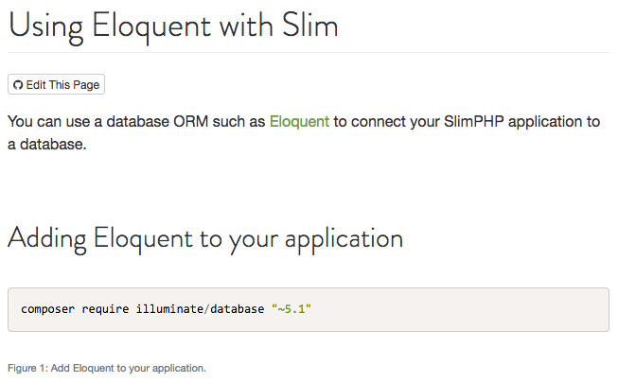
Eloquent
https://www.slimframework.com/docs/cookbook/database-eloquent.html

Slide 13
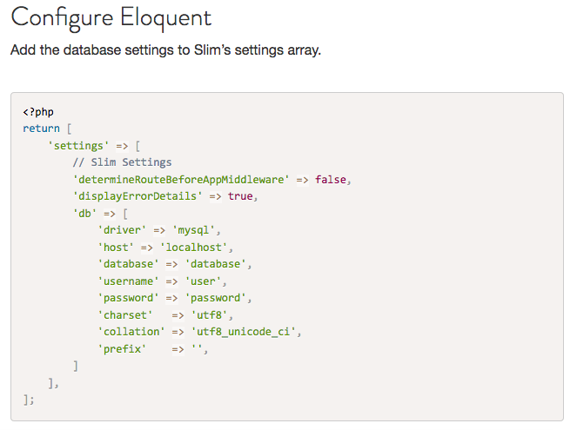
Eloquent
https://www.slimframework.com/docs/cookbook/database-eloquent.html

Slide 14
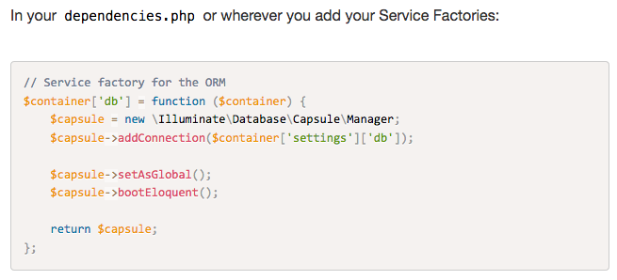
Eloquent
https://www.slimframework.com/docs/cookbook/database-eloquent.html

